Slide 1
Solving Simultaneous Equations Graphical
EQ – How do I solve simultaneous equations graphically?

Slide 2
Learning Objectives
Understand the idea of a solution for two equations.
Find how to do this by drawing the graphs.

Slide 3

Solving Simultaneous Equations Graphically EQ – How do I solve simultaneous equations graphically?
Task:
Find the gradient of the line perpendicular to the line $y=5x−2$.
Solve and represent of a number line
$$3x+2>10$$
Find the exact volume of a sphere with a diameter of 10m.
What is the gradient and y-intercept of the line $2y=5x+8$

Slide 4

Solving Simultaneous Equations Graphically EQ – How do I solve simultaneous equations graphically?
Inquiry
Task:
Draw on the coordinate grid the following lines and find the point where they cross.
$$\left\{\begin{aligned}y=3x−2 \\ y=−2x+3\end{aligned}\right.$$

Slide 5
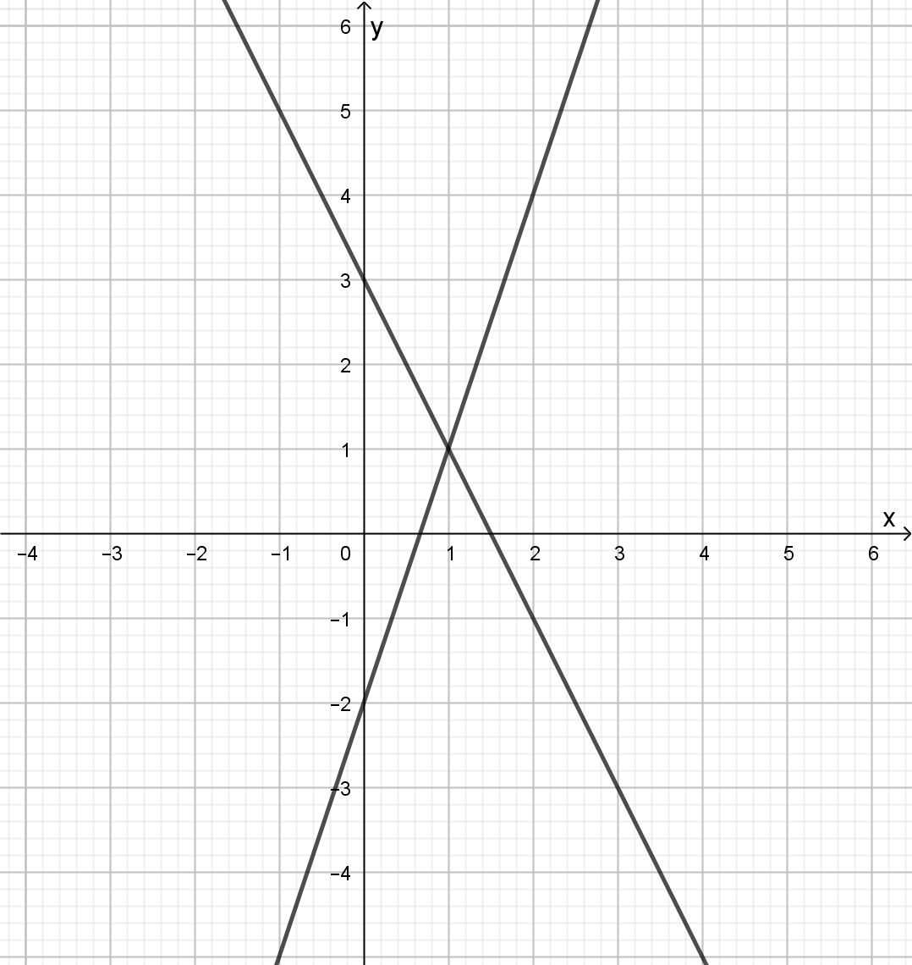

Solving Simultaneous Equations Graphically EQ – How do I solve simultaneous equations graphically?
Inquiry
Task:
Draw on the coordinate grid the following lines and find the point where they cross.
$$\left\{\begin{aligned}y=3x−2 \\ y=−2x+3\end{aligned}\right.$$
They cross at the point (1,1)

Slide 6

Solving Simultaneous Equations Graphically EQ – How do I solve simultaneous equations graphically?
Writing
What does it mean when you are asked to solve simultaneous equations?
Two linear equations can be solved at the same time to get a solution for $x$ and $y$ that makes both statements true.
These can be solved both graphically and algebracically.
Example : Solve the pair of simultaneous equations using a graph
$$\left\{\begin{aligned}y=3x−2 \\ y=−2x+3\end{aligned}\right.$$
Draw the lines on a Cartesian plane.
Find the point of intersection
These two lines cross at the point (1,1)
So the solution to the simultaneous equations is
$x=1$ and $y=1$

Slide 8

Exit Pass
Find the solution for the following simultaneous equations
$$\left\{\begin{aligned}x+y=\text{4} \\ y=x+2\end{aligned}\right.$$

